Slide 1


SMS Messenger Software Project
Sibyl
By Naman Mishra, Saharsha Magar, Benjamin Welch, Harry Seo, Jay Jhamb, Justin Pham, Mingxuan Wei, Samantha Boden
The Birth of Sibyl
Notes:
Naman M

Slide 2

Sibyl's Objective
We will create an SMS Messenger Service (named Sibyl – collective decision) for our project.
With the utilization of key technological tools such as P2P (peer-to-peer) networking, local database storage, and quantum cryptography, our plan is to create a messaging service that suffices the generic features found in mainstream SMS applications and integrates quantum cryptography to ensure safe and secure messaging.
Our team consists of members with experience ranging in cybersecurity to an understanding of distributed application architecture, with all members having experience in using SMS messaging software.
Notes:
Naman Mishra

Slide 3




Cost Estimation [Function Point Calculation]
Function Point (FP) Categories:
-> User Inputs = 7 (Count) * 3 (Complexity) = 21.
-> User Outputs = 2 (Count) * 4 (Complexity) = 8.
-> User Queries = 3 (Count) * 3 (Complexity) = 9.
-> Data / Relational = 3 (Count) * 7 (Complexity) = 21.
-> External Interfaces = 4 (Count) * 5 (Complexity) = 20.
Therefore, Total Function Points = 21+8+9+21+20 = 79.
Notes:
Harry

Slide 4




Cost Estimation [PCA & FP Calculation]
PCA (Processing Complexity Adjustment) Calculation:
-> Formula => PCA = 0.65 + 0.01 * (Sum of Complexity Components)
=> PCA = 0.65 + 0.01 (4+5+0+1+0+4+0+1+1+0+0+1+0+3)
=> PCA = 0.85.
Therefore, Adjusted Final Function Points: (IFP = Initial Function Points, Last slide)
FP => PCA * IFP => 0.85 * 79 = 67.15 ≈ 68 (Analogous Estimate).
Notes:
Benjamin

Slide 5


Cost Estimation [Final Total Cost]
Development Work and Time Required:
-> Total Time Distribution:
--> COA (Creation of Account) System => 2 Hours.
--> External Interface and Debugging Process => 30 Hours (This includes server/client infrastructure).
--> User Input/Output System => 7 Hours.
--> User Interface and Encryption System => 10 Hours.
-> Total Development Time = 68 Hours (This is Analogous to FP)
Labor Costs:
-> Number of Members: 8.
-> Hours per week, per person: 2 Hours.
-> Total Development Weeks: 4.25 Weeks.
-> Final Labor Costs: 68 Hours * $23 per hour (Average Intern Pay) = $1564.
Hardware and Software Costs:
-> 2 months holding of server: $54 per month * 2 = $108.
-> Software (IntelliJ for 8 members): $270.40
-> Total Project Cost: $1,564 (Personnel) + $270.40 (Software) + $108 (Server) = $1,942.40
Notes:
Benjamin

Slide 6

Project Timeline
Initial Design
Define core functionalities and requirements
Risk Analysis
Development
Evaluate potential risks and refine the design
Plan and build initial prototype with basic features
Testing
Full Implementation
Integrate features, conduct testing to ensure components work together
Finalize encryption, UI, and testing
Notes:
Samantha
Initial Design:
Focus: Define core functionalities (P2P messaging, user login, basic encryption).
Goal: Create initial design and prototype for essential features.
Risk Analysis:
Focus: Identify technical risks (network stability, encryption vulnerabilities).
Goal: Evaluate potential risks and refine the design based on feedback.
Development:
Focus: Build prototype with basic features; test and gather feedback.
Goal: Develop core functionality (messaging, sign-up/login, basic encryption) and iterate.
Testing
Focus: Integrate features, conduct extensive testing, and finalize messaging system.
Goal: Ensure all components work together, focusing on bug fixing, encryption
Full implementation
Focus: Finalize advanced encryption, complete UI, conduct full testing.
Goal: Implement full app functionality, including security features, finalize release.

Slide 7


Functional Requirements
P2P Networking System.
Text-Based SMS Application.
User Sign-Up and Log-In.
Customizable User Interface.
Real-Time User Notifications.
Privacy and Message Security with Cryptography.
Managing Contacts and Adding Restrictions
Notes:
Naman M
1- Cuts latency between messages and provides added privacy as information does not need to be stored in a central server (which can also be a security risk).
2 - Users are able to send/receive messages (including attachments – photos, videos, or links) with negligible delay in between messages thanks to P2P.
3 - Users should be able to sign up to the service and log-in (once they are registered) to the service. Password not required as long as 2FA is enabled with email and text-message methods for verification of identity. On default, users should be logged in with their numbers.
4 - Users should be able to change colors and implement themes based on their liking for both the application and the direct messaging space. Both users in a dm space can make and view theme changes on either end, with a default picture put in place as well.
5 - Users should be notified if new messages are sent from added friends. Additionally, more notifications should be provided for new friend requests and possible software updates. The alerts should be real-time to keep the user informed.
6 - Sibyl utilizes QKD (Quantum Key Distribution) for secure and encrypted communication between accepted parties. This is also a mechanism for real-time protection (it is a cybersecurity solution) against unauthorized access by bad actors.
7 - Users can add their contacts, remove them, or restrict their friends. They are also provided with the opportunity to block contact if needed.

Slide 8

Non-Functional Requirements
Usability Requirements
Performance Requirements
Space Requirements
Dependability Requirements
Security Requirements
Environmental Requirements
Operational Requirements
Developmental Requirements
Regulatory Requirements
Ethical Requirements
Accounting Requirements
Additional Safe/Security Requirements
Notes:
Mingxuan
Usability Requirements: The interface should be intuitive for easy message sending after minimal learning. Multi-language support, clear error messages, and status updates are essential, with full accessibility for users with disabilities.
Performance Requirements: The system must handle high message throughput, minimizing delays even with many concurrent users, and keeping database queries quick for a seamless experience.
Space Requirements: Efficient storage compression is needed within a 1TB limit, with twice that for backups. Client apps should remain lightweight for easy installation and updates.
Dependability Requirements: Reliable service is critical, requiring high uptime, automatic fail-over, and regular backups to ensure minimal data loss and quick recovery in emergencies.
Security Requirements: End-to-end message encryption and two-factor authentication are essential. Rate limiting and compliance with data protection regulations ensure secure access and operation.
Environmental Requirements: The system must run smoothly across platforms, use minimal battery on mobile, adapt to varying network conditions, and deploy via the cloud for scalability.
Operational Requirements: Monitoring, error reporting, auto-scaling, and load balancing are vital, with regular maintenance and a disaster recovery plan in place and tested regularly.
Development Requirements: Development should follow modern practices, with version control, full testing, and thorough documentation of the code and interfaces.
Regulatory Requirements: The system must comply with GDPR, local telecom regulations, and data privacy laws, with content filtering and audit-ready data exports as required.
Ethical Requirements: A transparent privacy policy, clear terms of service, and user consent for data collection are required, with responsible AI and ethical data usage practices.
Accounting Requirements: Track usage accurately with monthly reports, secure payment processing, and audit trails. Generate automatic invoices and allow cost allocation by user or department.
Safety/Security Requirements: Robust spam and malicious content filtering, user blocking, and abuse reporting ensure user safety, with secure data wiping and prioritization for urgent messages.

Slide 9
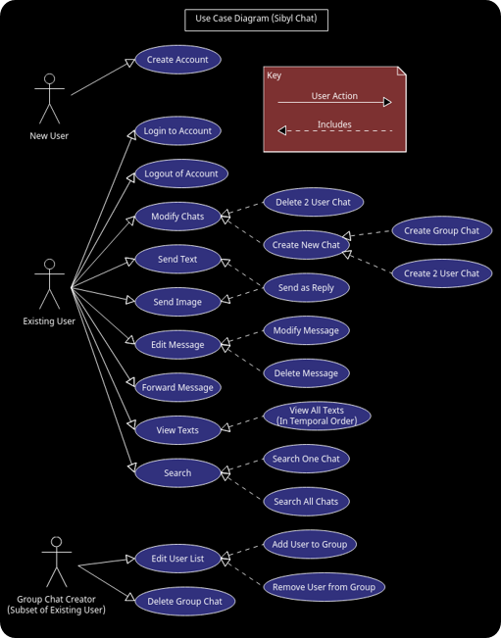


Use Case
This use case diagram shows the flow of actions for both new and existing users in the Sibyl Chat application.
New users can create an account, while existing users have a broad range of actions, including logging in, managing chats, sending messages, editing messages, and searching.
The subset role, Group Chat Creator, adds and removes users from group chats and can delete the group chat if needed.
The diagram covers essential features for a messaging application focused on peer-to-peer and group communication.
Notes:
Benjamin

Slide 10
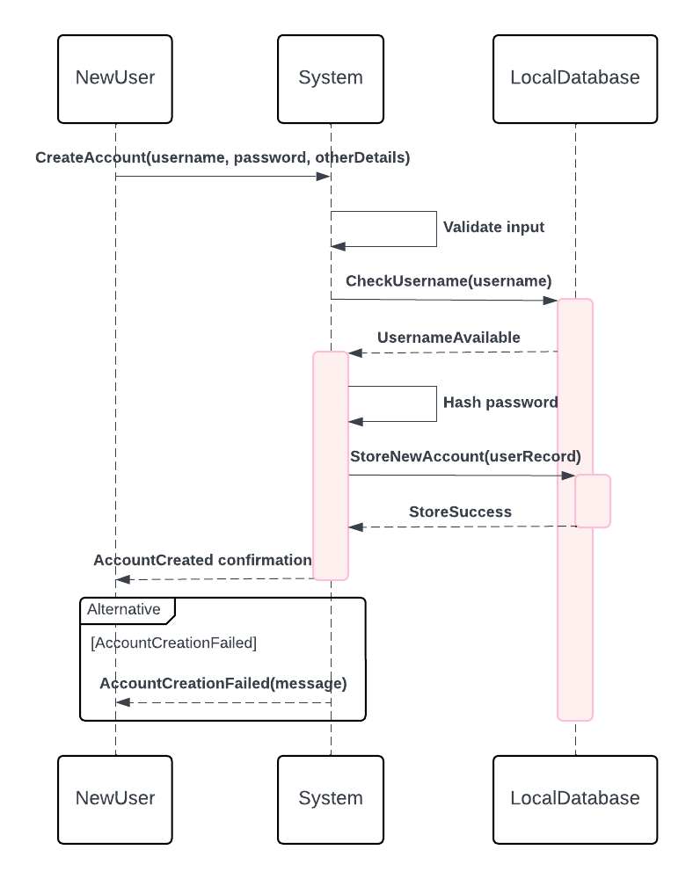



Sequence Diagram
This diagram illustrates the process of creating a new account.
The New User initiates a request to the System to create an account, which involves validating input, checking if the username is available, and hashing the password.
If the username is available, the System stores the new account details in Local Database and returns a success message.
If an error occurs, an alternative flow returns an account creation failure message.
Notes:
Jay – It’s important to consider the sequence of each event inside the app, as this will help us better understand what the application needs and what the user will look for when clicking buttons.
Firstly, we have the sequence diagram for creating a new account
A new user sends a request to the system to create an account, then validates the input by checking if the username is available and hashing the password.
If all is good, the system will store the new account details in the local database and return a success message.
We also delegated an error passage where it returns an account creation failure message if there is an error along the way.

Slide 11
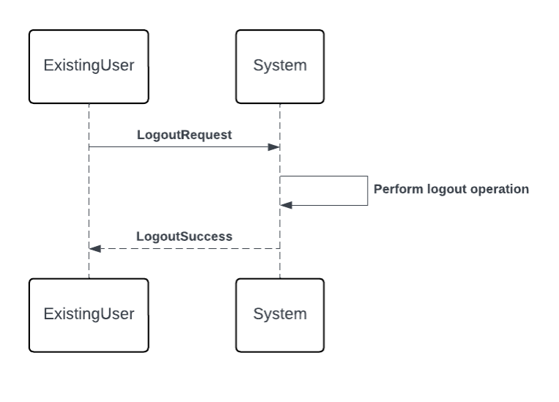
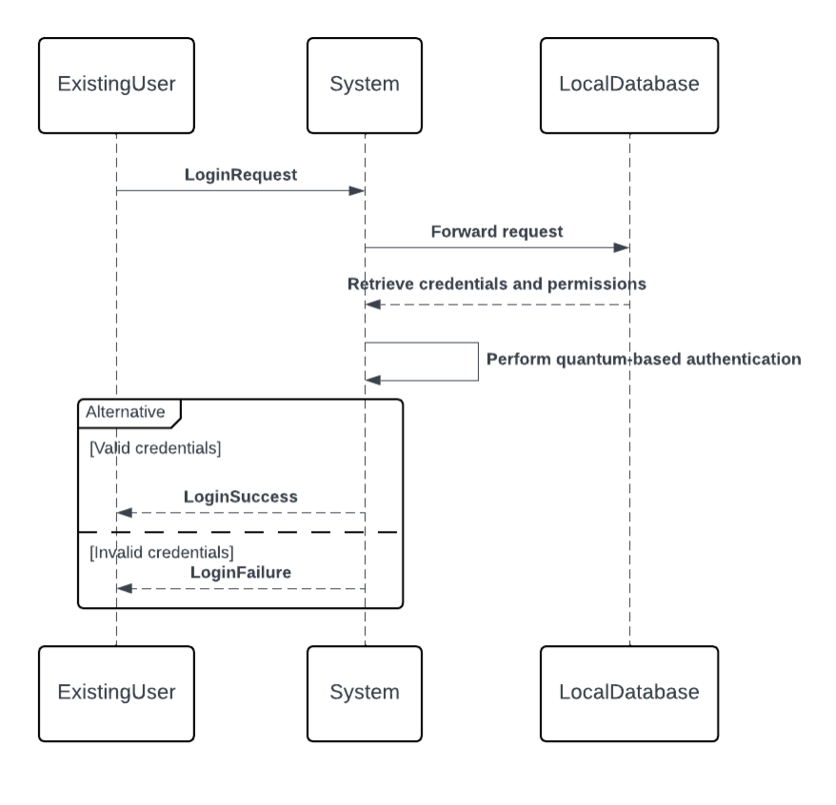

User Login and Logout
The Existing User sends a login request to the System.
The System retrieves credentials from the Local Database and performs quantum-based authentication.
If credentials are valid, login success is communicated to the user; otherwise, a login failure message is returned.
The Existing User initiates a logout request to the System.
The System processes the logout and confirms the operation back to the user.
Notes:
Jay - Here we have the user login and logout diagram:
Firstly, the user with an account will send a login request to the system.
The system will take the credentials from the database and perform the quantum-based authentication previously mentioned.
If these credentials are valid, then the login success or failure message is sent to the user.

Slide 12
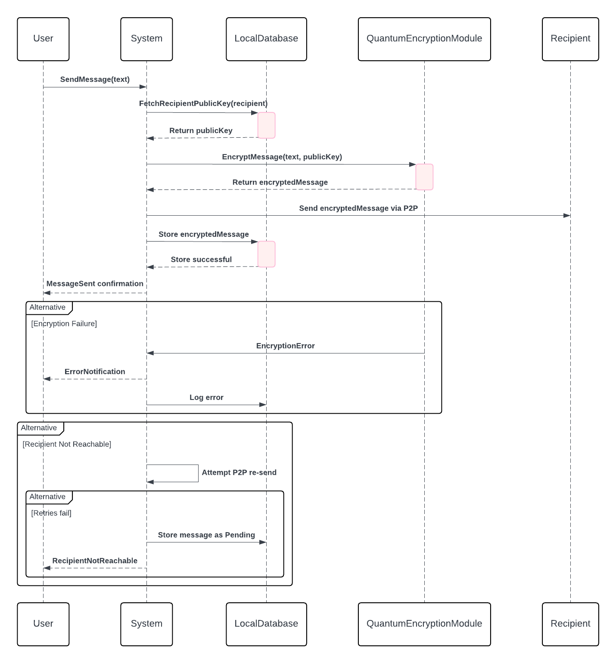



Send Message
The User sends a message to the System, which fetches the recipient’s public key from the Local Database.
The System encrypts the message with the public key using the Quantum Encryption Module and then sends it to the recipient.
If the message is stored successfully, a confirmation is sent back to the user.
If encryption or delivery fails, an error notification is logged, or the system may attempt re-sending.
Notes:
Jay- The send message sequence diagram looks a little more complicated however its a very simple procedure.
Firstly, we send messages to the system which will get the public key from the local database. Then the system encrypts the message with the public key using Quantum Encryption then sends it to the recipient.
If this message is stored successfully, then a confirmation is sent back to the user.
If the encryption or delivery fails then an error message is displayed or the system will attempt to re-send the message.

Slide 13
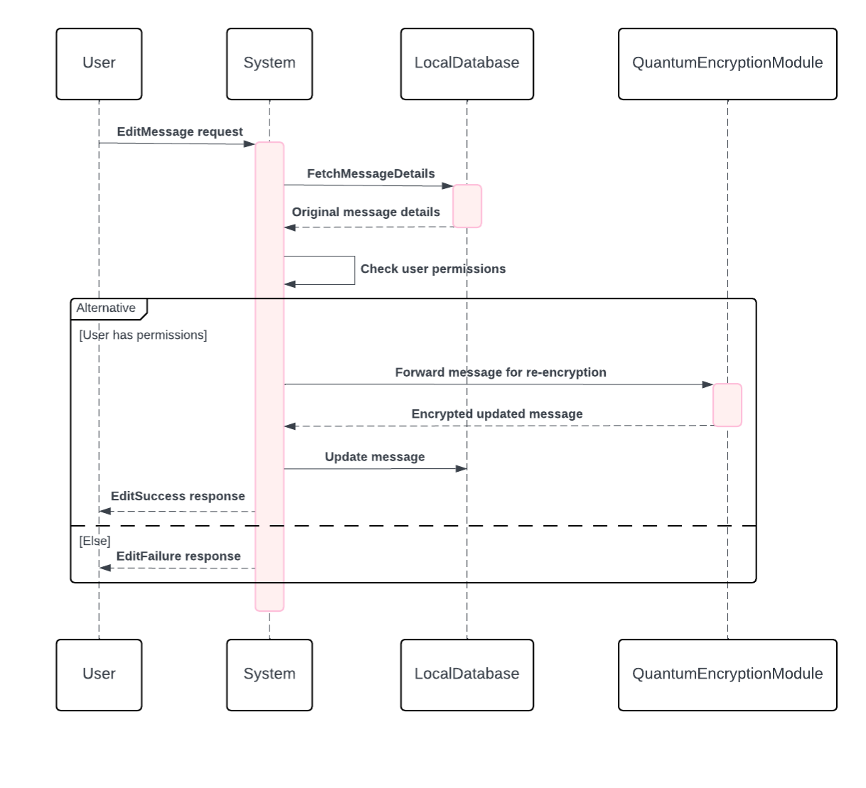




Edit Message
A user sends an edit request, and the System fetches the message details, checks permissions, and forwards the message for re-encryption if permissions are valid.
After encryption, the message is updated, and the system responds with success or failure based on permissions.
Notes:
Jay- Editing a message has multiple system requirements however itis quite a simple sequence.
Firstly, a user sends an edit request then the system fetches the message details, permissions, and the forwards the message for re-encryption if verified.
After the encryption, the message will be then updated and the system will respond with a success or failure dependent on user permissions.

Slide 14
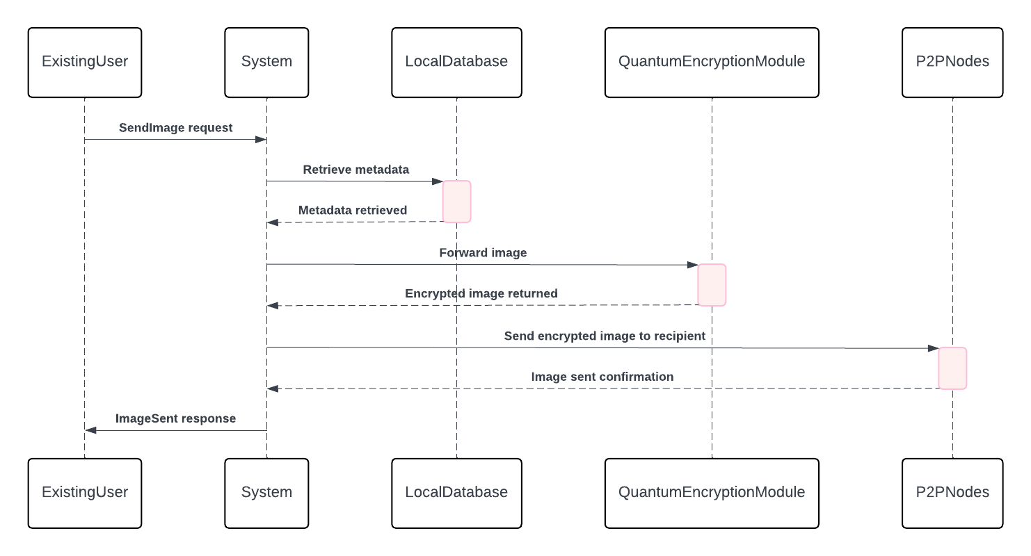


Send Image
The System retrieves metadata from Local Database, forwards it for encryption using the Quantum Encryption Module, and then sends the encrypted image to the recipient.
A confirmation response is sent back to the user upon successful image transmission.
Notes:
Justin Pham
This sequence diagram demonstrates the systems process for sending an image. It retrieves the metadata from the local database and forwards it to be encrypted by the Quantum Encryption Module. Afterwards, it is sent back as an encrypted image to the user, which gives a confirmation response upon a successful image transmission.

Slide 15
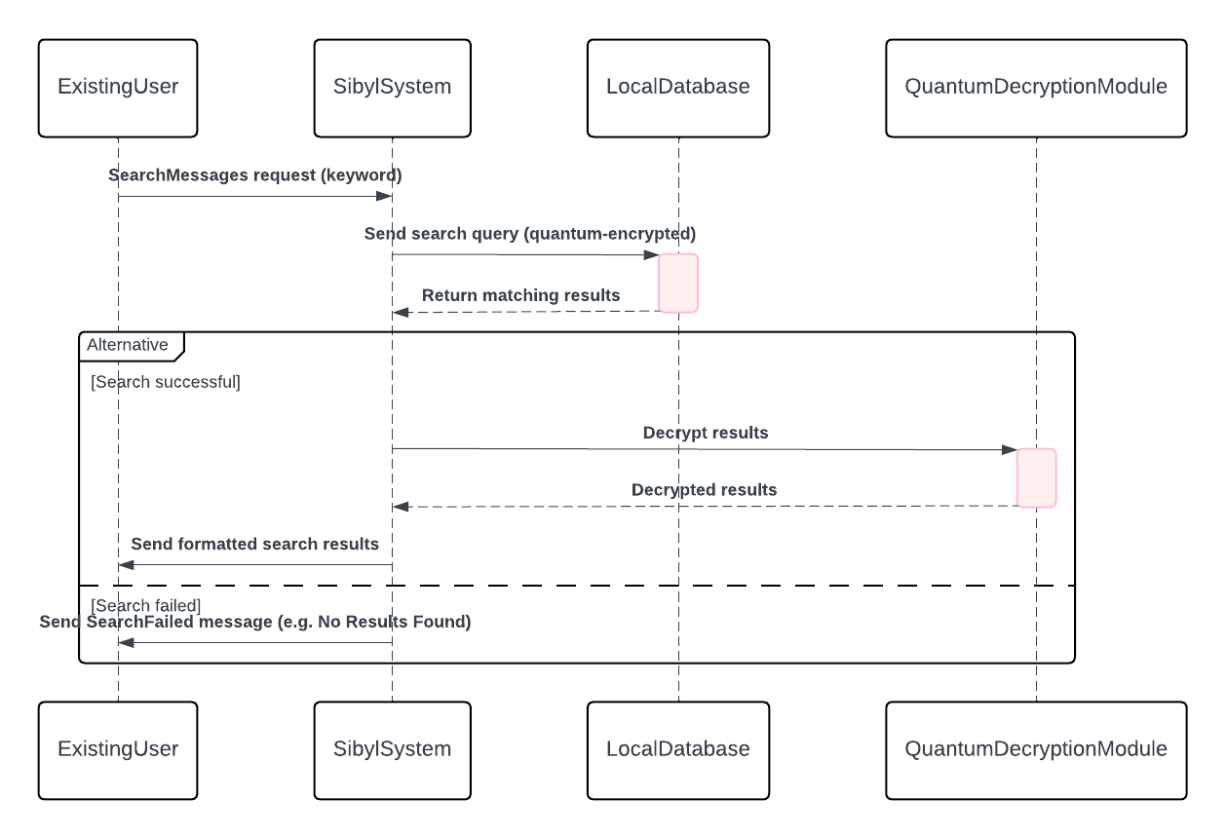


Search
The Existing User initiates a search by sending a keyword to the Sibyl System.
The Sibyl System sends a quantum-encrypted search query to the Local Database, which then returns matching results.
If successful, results are decrypted using the Quantum Decryption Module and formatted before being sent to the user.
If no results are found, a failure message is returned.
Notes:
Saharsha

Slide 16
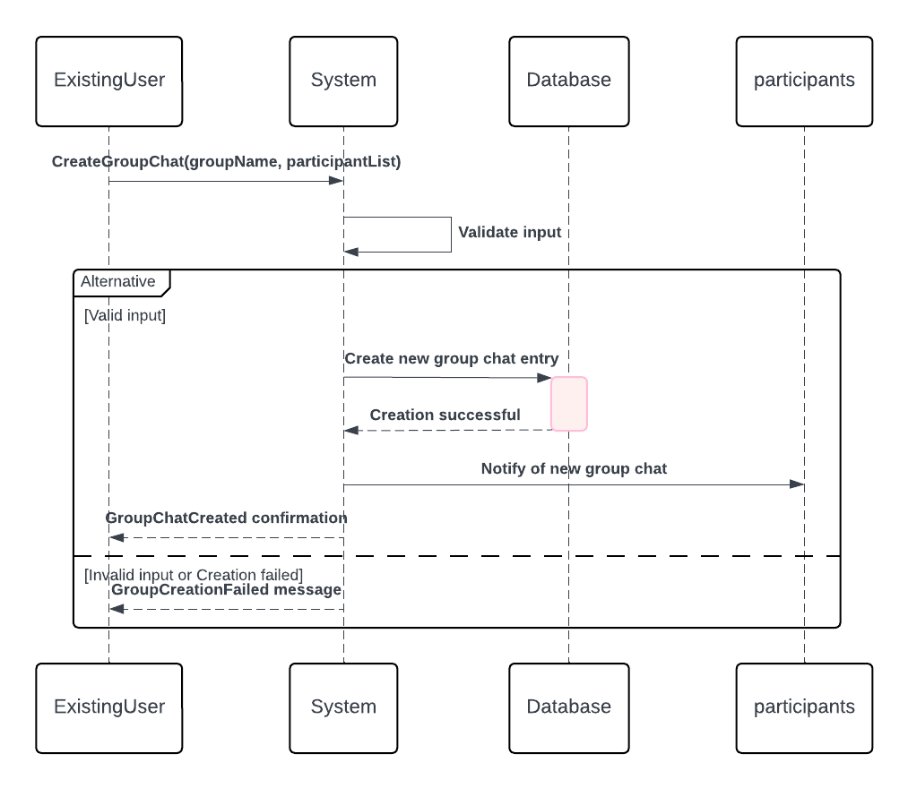
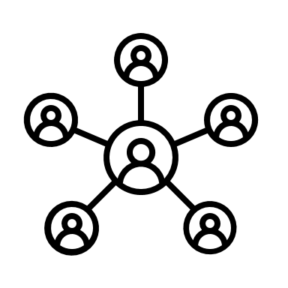
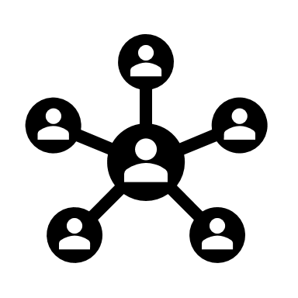
Group Chat
An Existing User requests the creation of a group chat, and the System validates input.
If valid, it creates a group chat entry in the Database and notifies participants of the new group.
If there's invalid input or a failure, a failure message is sent back to the user.
Notes:
Saharsha

Slide 17
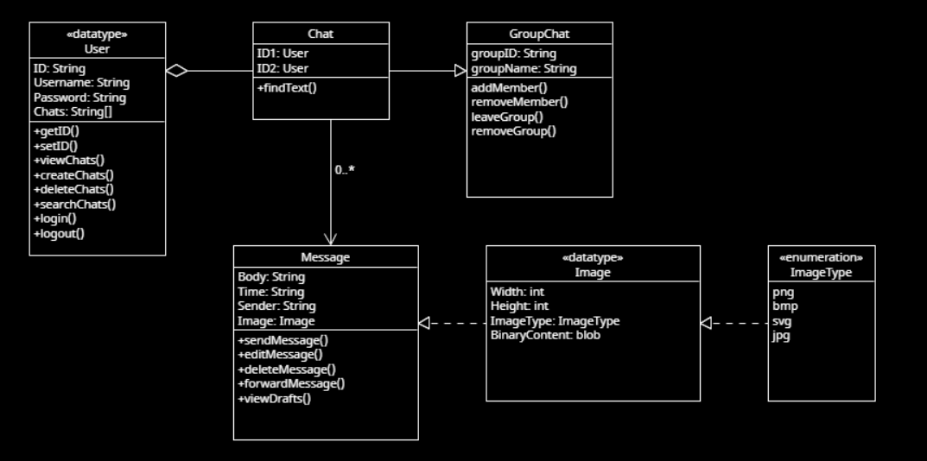

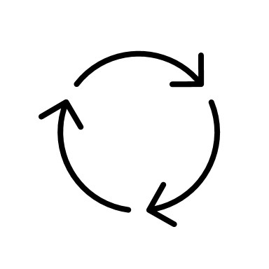

Class Diagram
The diagram illustrates a messaging system's structure where users can engage in direct or group chats, send text and image messages, and perform various chat and message management functions.
The Group Chat extends the Chat functionality to handle multiple participants, while the Message class allows handling of both text and image-based content.
Notes:
Justin Pham
The class diagram illustrates SIBYL's messaging structure, containing the users, the chats between users, a group chat with multiple users, messages, the images that can be sent in message, as well as the structure of images themselves. Some things to note is that Groupchat is an extension of the chat functionality to allow it to handle multiple participants, and the message class is able to handle both text and images

Slide 18
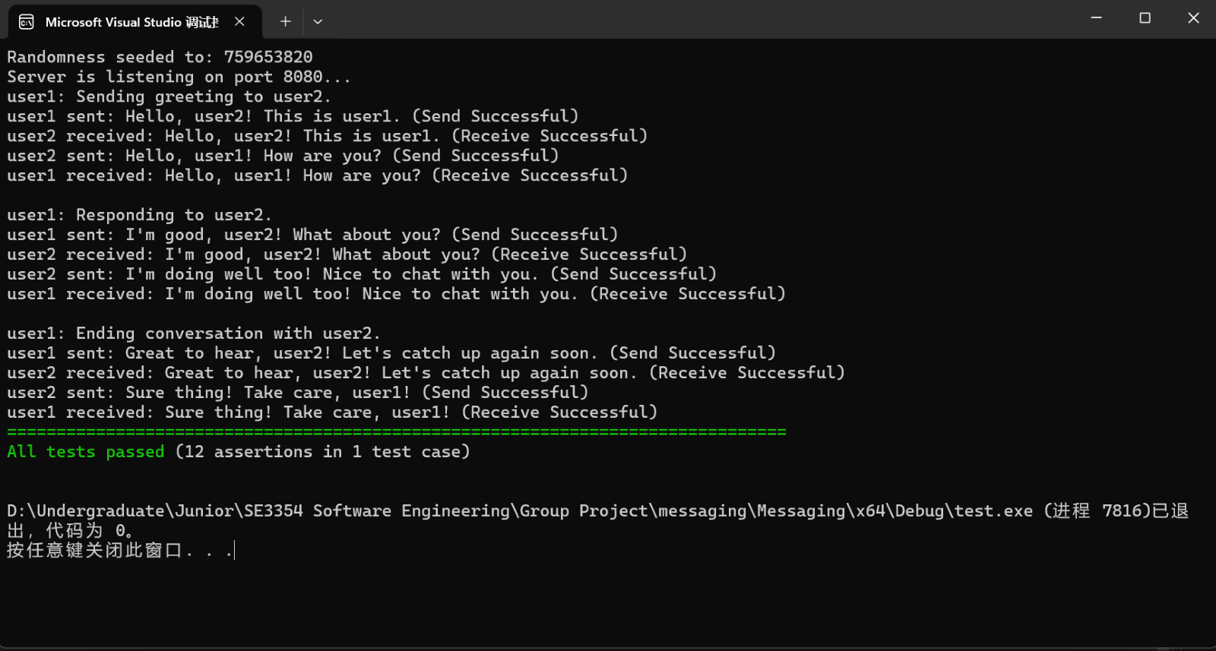


Test Case
Tests peer-to-peer messaging between two users
Total of one test case was executed, with a total of six unique messages verified
Notes:
Harry

Slide 19
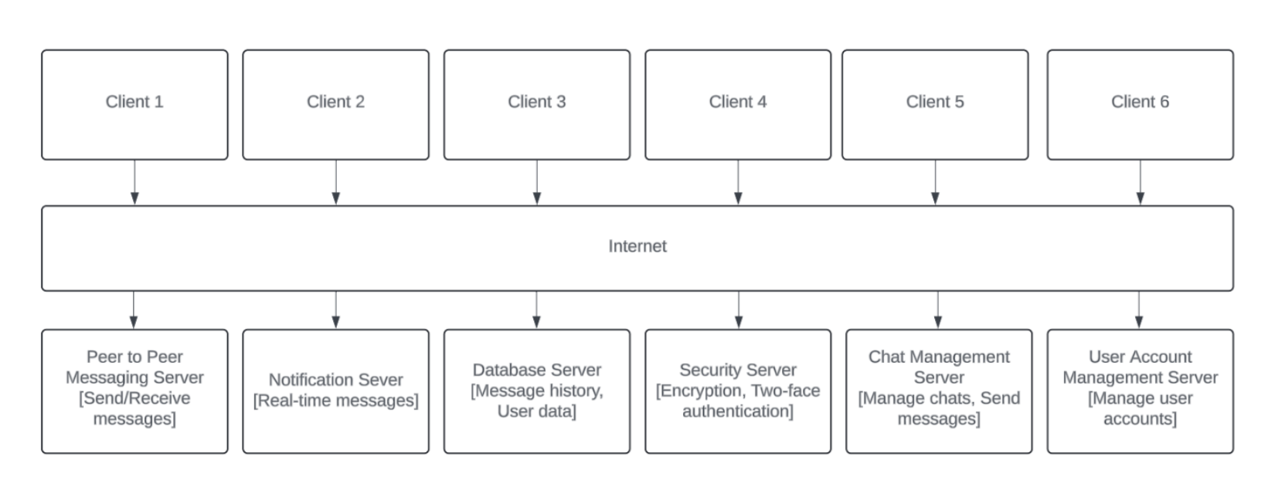


Client-Server Architecture Pattern
Peer-to-Peer Messaging Server - Manages direct message sending and receiving between clients.
Notification Server - Handles real-time notifications for new messages or alerts.
Database Server - Stores message history and user data.
Security Server - Provides encryption and two-factor authentication for secure communication.
Chat Management Server - Manages chat rooms, group chats, and message routing.
User Account Management Server - Manages user accounts, including login and registration.
Notes:
Samantha
Peer-to-Peer Messaging Server This server handles direct communication between users, allowing messages to be sent and received instantly. By managing this process directly, it reduces the need for centralized storage and enhances speed and privacy in communication.
Notification Server The Notification Server is responsible for sending real-time alerts, such as notifying users of new messages or other important updates. This keeps users informed and engaged with the app without delay.
Database Server This server stores essential data like message history and user information. It provides a backup for conversations and allows users to access past messages, ensuring data is available when needed.
Security Server To protect user data, this server provides encryption and two-factor authentication. Encryption secures messages during transmission, while two-factor authentication adds an extra layer of security for user access.
Chat Management Server
The Chat Management Server organizes user interactions, managing chat rooms, group chats, and routing messages to the correct users. It keeps conversations organized and supports a smooth user experience, especially in group settings.
User Account Management Server This server handles user account-related functions, including login, registration, and profile management. It ensures each user can securely log in and access their personal data, providing a foundation for account security and identity verification.

Slide 20


Thank you!
Sibyl
Does anybody have any questions?
~ Feel free to raise hands!
This concludes our presentation.
Notes:
Justin Pham – Conclusion:
Our project didn’t deviate from our initial plans, which was due in part to our pre-planning and risk assessment that we have outlined within our diagram and models, therefore, there was not much change at all in our work. In terms of our software development, we utilized a spiral model as our software development life cycle model of choice, and function points to estimate how long developing a component of the product would take. With a team of 8 developers working 2 hours a week, using the average software intern pay in Texas, we estimated $1564 as the approximate personnel cost. Our software planning was based on peer-to-peer messaging, whereas shown in our test case, we were able to send 6 unique messages between two users. Overall, our work was a success, with few little roadblocks encountered along the way.

